Slide 1
kNN & Naïve Bayes
Hongning Wang
CS@UVa

Slide 2
Today’s lecture
Instance-based classifiers
k nearest neighbors
Non-parametric learning algorithm
Model-based classifiers
Naïve Bayes classifier
A generative model
Parametric learning algorithm

Slide 3
How to classify this document?
Documents by vector space representation
?
Sports
Politics
Finance

Slide 4
Let’s check the nearest neighbor
Are you confident about this?
?
Sports
Politics
Finance

Slide 5
Let’s check more nearest neighbors
Ask k nearest neighbors
Let them vote
?
Sports
Politics
Finance

Slide 6

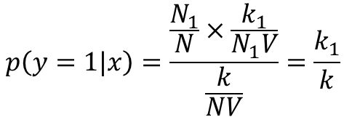
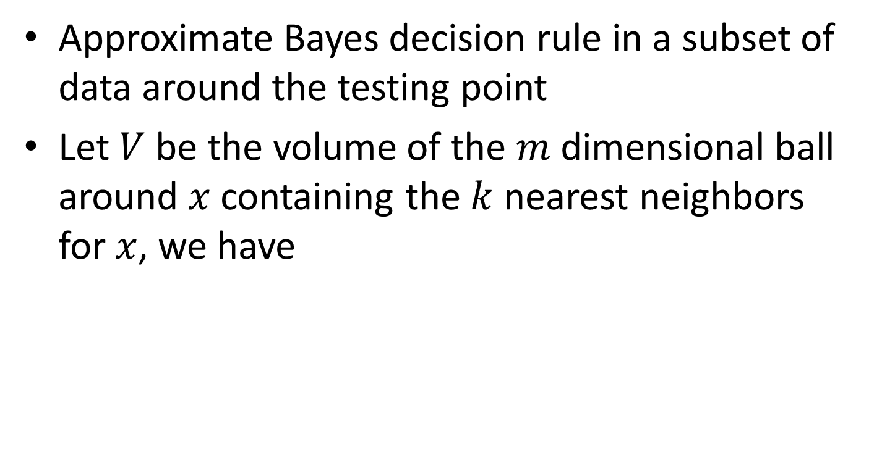



Probabilistic interpretation of kNN
Approximate Bayes decision rule in a subset of data around the testing point
Let $V$ be the volume of the $m$ dimensional ball around $x$ containing the $k$ nearest neighbors for $x$, we have
Nearest neighbors from class 1
$$p\left(x\right)V=\frac{k}{N}$$
$$p\left(x\right)=\frac{k}{NV}$$
$$p\left(x|y=1\right)=\frac{k_{1}}{N_{1}V}$$
$$p\left(y=1\right)=\frac{N_{1}}{N}$$
=>
Total number of instances
With Bayes rule:
Total number of instances in class 1
$$p\left(y=1|x\right)=\frac{\frac{N_{1}}{N}×\frac{k_{1}}{N_{1}V}}{\frac{k}{NV}}=\frac{k_{1}}{k}$$
Counting the nearest neighbors from class 1

Slide 7
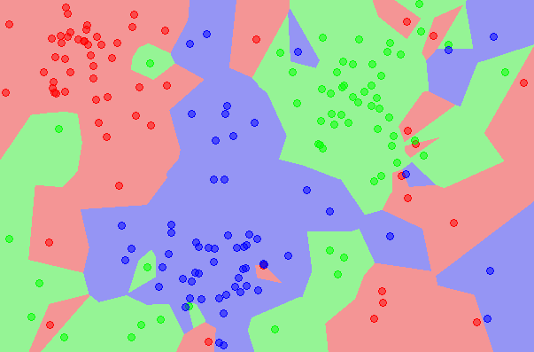
kNN is close to optimal
Asymptotically, the error rate of 1-nearest-neighbor classification is less than twice of the Bayes error rate
Decision boundary
1NN - Voronoi tessellation
A non-parametric estimation of posterior distribution

Slide 8
Components in kNN
A distance metric
Euclidean distance/cosine similarity
How many nearby neighbors to look at
k
Instance look up
Efficiently search nearby points

Slide 9
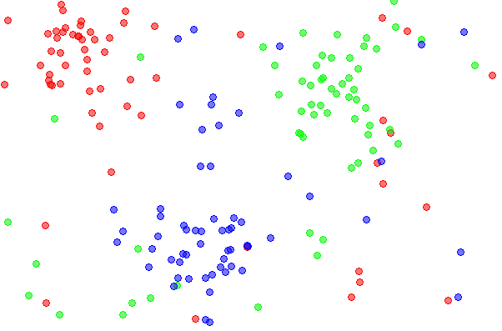
Effect of k
Choice of k influences the “smoothness” of the resulting classifier

Slide 10
Effect of k
Choice of k influences the “smoothness” of the resulting classifier
k=1

Slide 11
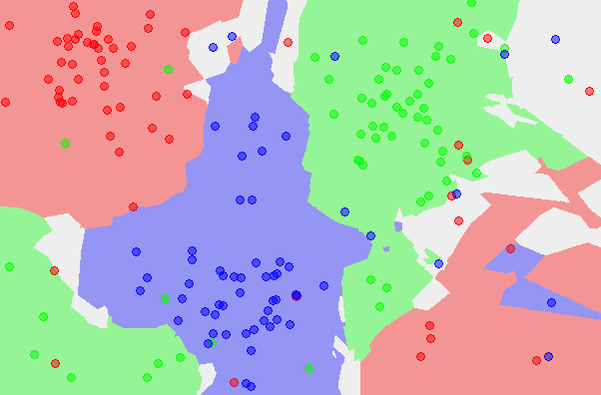
Effect of k
Choice of k influences the “smoothness” of the resulting classifier
k=5

Slide 12
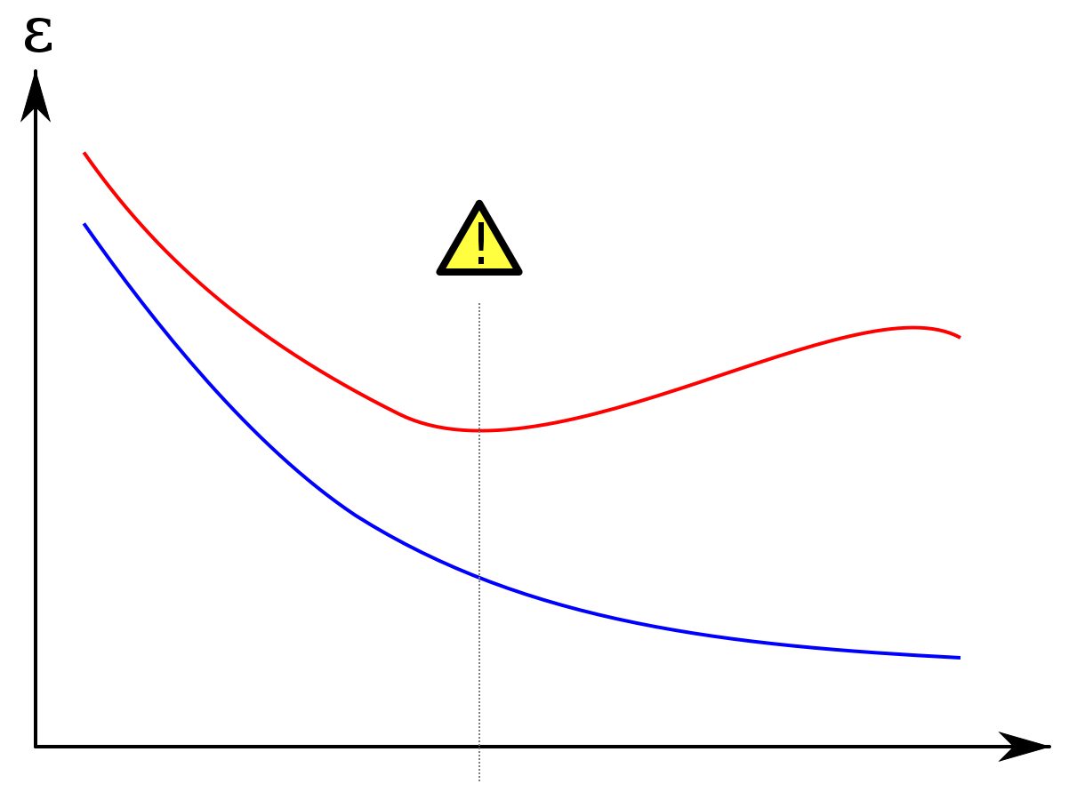
Effect of k
Large k -> smooth shape for decision boundary
Small k -> complicated decision boundary
Error
Error on testing set
Error on training set
Larger k
Smaller k
Model complexity

Slide 13
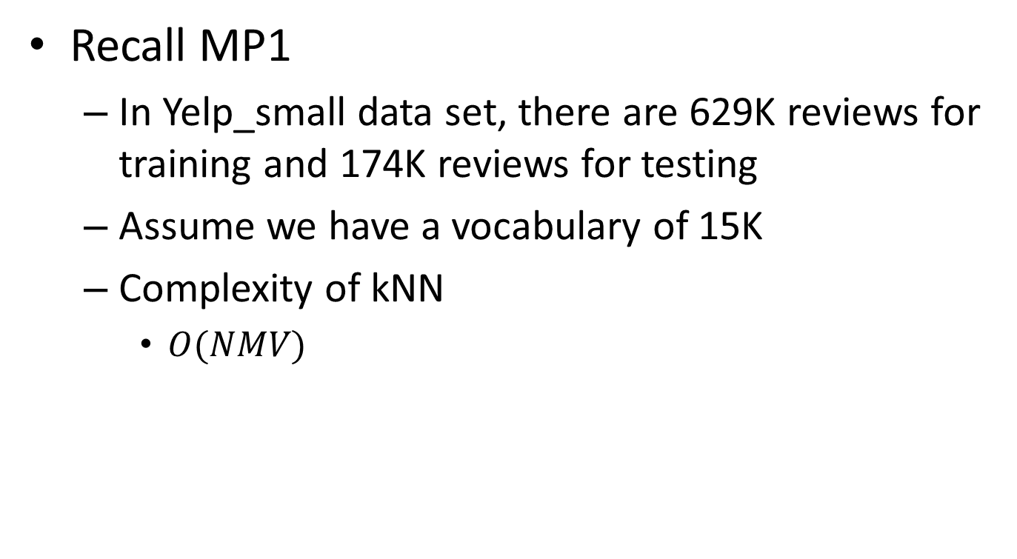
Efficient instance look-up
Recall MP1
In Yelp_small data set, there are 629K reviews for training and 174K reviews for testing
Assume we have a vocabulary of 15K
Complexity of kNN
$O(NMV)$
Feature size
Training corpus size
Testing corpus size

Slide 14
Efficient instance look-up
Exact solutions
Build inverted index for text documents
Special mapping: word -> document list
Speed-up is limited when average document length is large
Dictionary
Postings
information
retrieval
retrieved
is
helpful
Doc1
Doc2
Doc1
Doc2
Doc1
Doc2
Doc1
Doc2

Slide 15
Efficient instance look-up
Exact solutions
Build inverted index for text documents
Special mapping: word -> document list
Speed-up is limited when average document length is large
Parallelize the computation
Map-Reduce
Map training/testing data onto different reducers
Merge the nearest k neighbors from the reducers

Slide 16
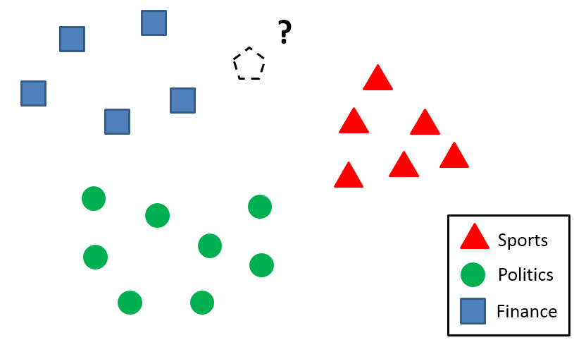

Efficient instance look-up
Approximate solution
Locality sensitive hashing
Similar documents -> (likely) same hash values
h(x)

Slide 17
Efficient instance look-up
Approximate solution
Locality sensitive hashing
Similar documents -> (likely) same hash values
Construct the hash function such that similar items map to the same “buckets” with high probability
Learning-based: learn the hash function with annotated examples, e.g., must-link, cannot-link
Random projection

Slide 18







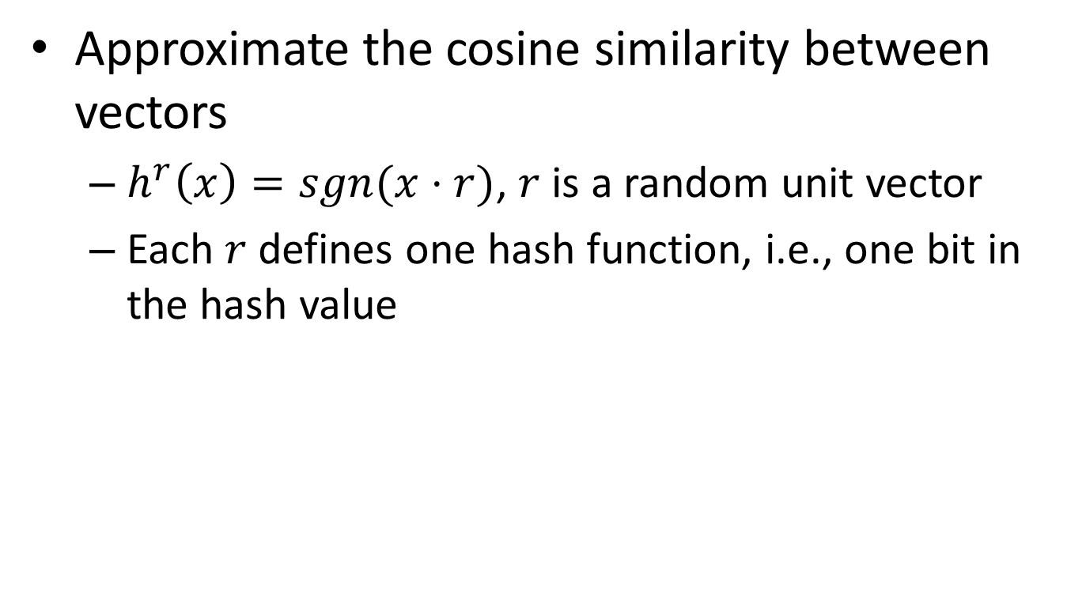










Random projection
Approximate the cosine similarity between vectors
$h^{r}\left(x\right)=sgn(x⋅r)$, $r$ is a random unit vector
Each $r$ defines one hash function, i.e., one bit in the hash value
 | 1 | 1 | 0
 | 1 | 0 | 1
$$r_{1}$$
$$r_{2}$$
$$r_{3}$$
$$D_{x}$$
$$D_{y}$$
$$r_{1}$$
$$D_{x}$$
$$D_{x}$$
$$D_{x}$$
$$θ$$
$$θ$$
$$θ$$
$$r_{2}$$
$$D_{y}$$
$$D_{y}$$
$$D_{y}$$
$$r_{3}$$

Slide 19








Random projection
Approximate the cosine similarity between vectors
$h^{r}\left(x\right)=sgn(x⋅r)$, $r$ is a random unit vector
Each $r$ defines one hash function, i.e., one bit in the hash value
 | 1 | 0 | 1
 | 1 | 0 | 1
$$r_{1}$$
$$r_{2}$$
$$r_{3}$$
$$D_{x}$$
$$D_{y}$$
$$r_{1}$$
$$D_{x}$$
$$D_{x}$$
$$D_{x}$$
$$θ$$
$$θ$$
$$r_{2}$$
$$θ$$
$$D_{y}$$
$$D_{y}$$
$$D_{y}$$
$$r_{3}$$

Slide 20
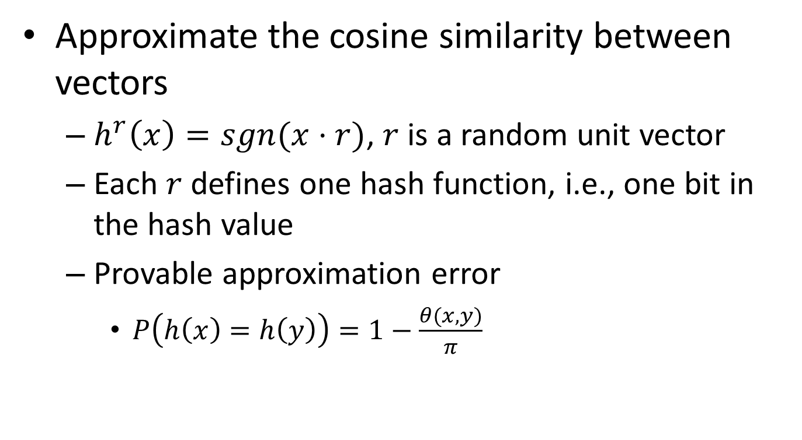
Random projection
Approximate the cosine similarity between vectors
$h^{r}\left(x\right)=sgn(x⋅r)$, $r$ is a random unit vector
Each $r$ defines one hash function, i.e., one bit in the hash value
Provable approximation error
$P\left(h\left(x\right)=h\left(y\right)\right)=1−\frac{θ(x,y)}{π}$

Slide 21
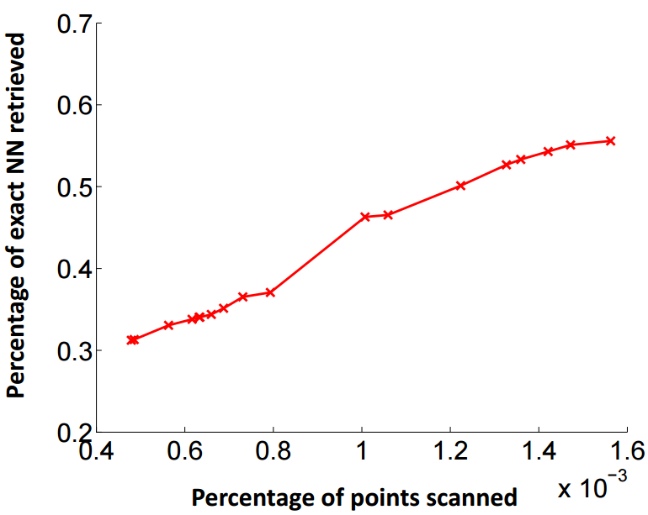
Efficient instance look-up
Effectiveness of random projection
1.2M images + 1000 dimensions
1000x speed-up

Slide 22
Weight the nearby instances
When the data distribution is highly skewed, frequent classes might dominate majority vote
They occur more often in the k nearest neighbors just because they have large volume
?
Sports
Politics
Finance

Slide 23
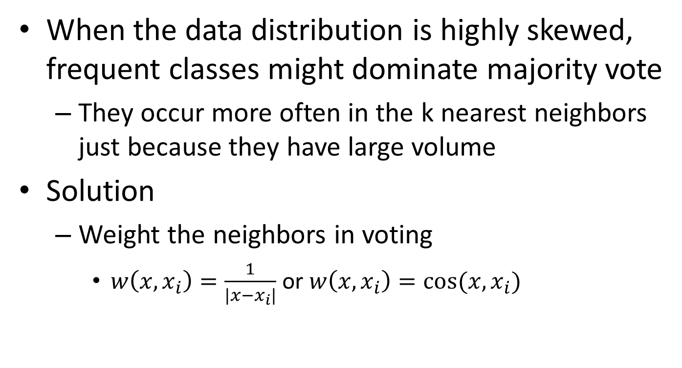
Weight the nearby instances
When the data distribution is highly skewed, frequent classes might dominate majority vote
They occur more often in the k nearest neighbors just because they have large volume
Solution
Weight the neighbors in voting
$w\left(x,x_{i}\right)=\frac{1}{|x−x_{i}|}$ or $w\left(x,x_{i}\right)=cos⁡(x,x_{i})$

Slide 24
Summary of kNN
Instance-based learning
No training phase
Assign label to a testing case by its nearest neighbors
Non-parametric
Approximate Bayes decision boundary in a local region
Efficient computation
Locality sensitive hashing
Random projection

Slide 25
Recap: probabilistic interpretation of kNN
Approximate Bayes decision rule in a subset of data around the testing point
Let $V$ be the volume of the $m$ dimensional ball around $x$ containing the $k$ nearest neighbors for $x$, we have
Nearest neighbors from class 1
$$p\left(x\right)V=\frac{k}{N}$$
$$p\left(x\right)=\frac{k}{NV}$$
$$p\left(x|y=1\right)=\frac{k_{1}}{N_{1}V}$$
$$p\left(y=1\right)=\frac{N_{1}}{N}$$
=>
Total number of instances
With Bayes rule:
Total number of instances in class 1
$$p\left(y=1|x\right)=\frac{\frac{N_{1}}{N}×\frac{k_{1}}{N_{1}V}}{\frac{k}{NV}}=\frac{k_{1}}{k}$$
Counting the nearest neighbors from class 1

Slide 26
Recap: effect of k
Large k -> smooth shape for decision boundary
Small k -> complicated decision boundary
Error
Error on testing set
Error on training set
Larger k
Smaller k
Model complexity

Slide 27
Recap: efficient instance look-up
Approximate solution
Locality sensitive hashing
Similar documents -> (likely) same hash values
h(x)

Slide 28
Random projection
Approximate the cosine similarity between vectors
$h^{r}\left(x\right)=sgn(x⋅r)$, $r$ is a random unit vector
Each $r$ defines one hash function, i.e., one bit in the hash value
 | 1 | 1 | 0
 | 1 | 0 | 1
$$r_{1}$$
$$r_{2}$$
$$r_{3}$$
$$D_{x}$$
$$D_{y}$$
$$r_{1}$$
$$D_{x}$$
$$D_{x}$$
$$D_{x}$$
$$θ$$
$$θ$$
$$θ$$
$$r_{2}$$
$$D_{y}$$
$$D_{y}$$
$$D_{y}$$
$$r_{3}$$

Slide 29
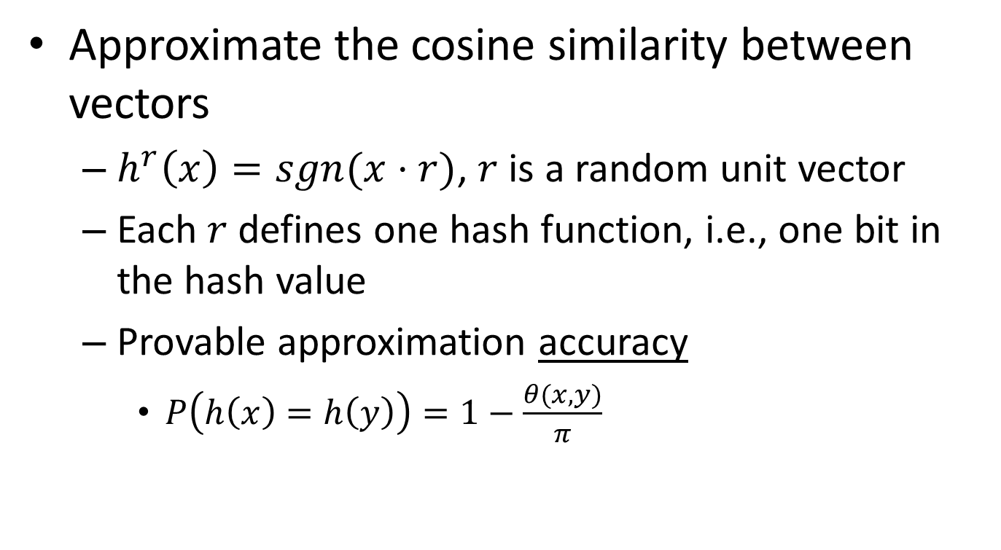
Recap: random projection
Approximate the cosine similarity between vectors
$h^{r}\left(x\right)=sgn(x⋅r)$, $r$ is a random unit vector
Each $r$ defines one hash function, i.e., one bit in the hash value
Provable approximation accuracy
$P\left(h\left(x\right)=h\left(y\right)\right)=1−\frac{θ(x,y)}{π}$

Slide 30





Recall optimal Bayes decision boundary
$f\left(X\right)=argmax_{y}P(y|X)$
*Optimal Bayes decision boundary
$$p(X,y)$$
$$\hat{y}=0$$
$$\hat{y}=1$$
$$p\left(X | y=0\right)p(y=0)$$
$$p\left(X | y=1\right)p(y=1)$$
$$X$$
False negative
False positive

Slide 31





Estimating the optimal classifier
$f\left(X\right)=argmax_{y}P\left(y | X\right)$
Requirement:
$$=argmax_{y}P\left(X | y\right)P(y)$$
$$\text{|}\text{D}\text{|>>}\left|Y\right|×(2^{V}−1)$$
Class conditional density
Class prior
#parameters:
$$\left|Y\right|×(2^{V}−1)$$
$$\left|Y\right|−1$$
 | text | information | identify | mining | mined | is | useful | to | from | apple | delicious | Y
D1 | 1 | 1 | 1 | 1 | 0 | 1 | 1 | 1 | 0 | 0 | 0 | 1
D2 | 1 | 1 | 0 | 0 | 1 | 1 | 1 | 0 | 1 | 0 | 0 | 1
D3 | 0 | 0 | 0 | 0 | 0 | 1 | 0 | 0 | 0 | 1 | 1 | 0
V binary features

Slide 32

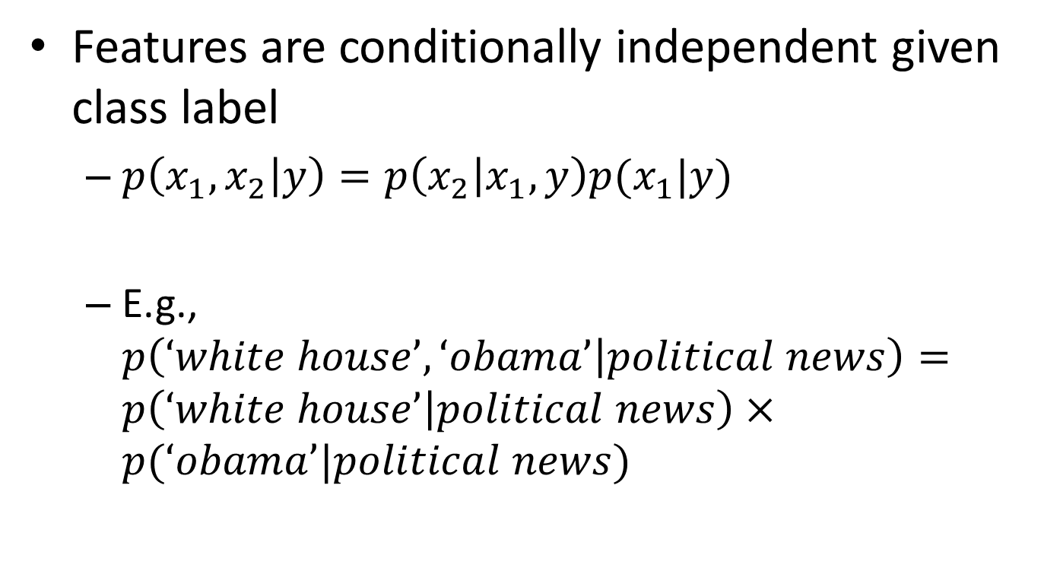
We need to simplify this
Features are conditionally independent given class label
$p\left(x_{1},x_{2} | y\right)=p\left(x_{2} | x_{1},y\right)p(x_{1}|y)$
E.g., $p\left(‘white house’,‘obama’ | political news\right)=p\left(‘white house’ | political news\right)×p(‘obama’|political news)$
$$=p\left(x_{2} | y\right)p(x_{1}|y)$$
This does not mean ‘white house’ is independent of ‘obama’!

Slide 33
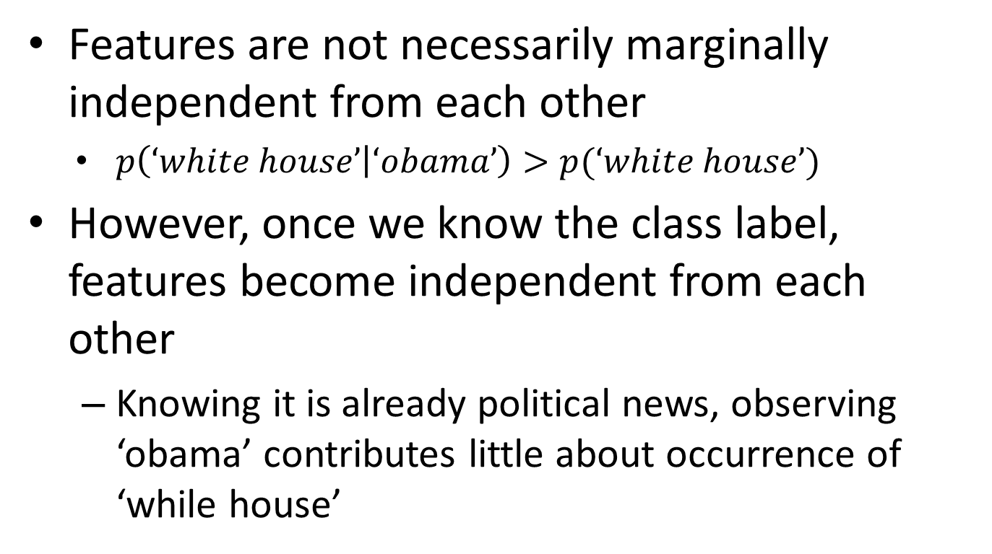
Conditional v.s. marginal independence
Features are not necessarily marginally independent from each other
$p\left(‘white house’ | ‘obama’\right)>p(‘white house’)$
However, once we know the class label, features become independent from each other
Knowing it is already political news, observing ‘obama’ contributes little about occurrence of ‘while house’

Slide 34




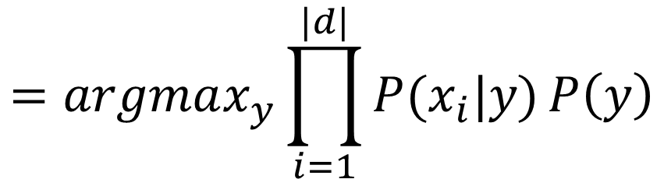
Naïve Bayes classifier
$f\left(X\right)=argmax_{y}P\left(y | X\right)$
$$=argmax_{y}P\left(X | y\right)P(y)$$
$$=argmax_{y}\prod_{i=1}^{|d|}{P(x_{i}|y)}P\left(y\right)$$
Class conditional density
Class prior
#parameters:
$$\left|Y\right|×(V−1)$$
$$\left|Y\right|−1$$
v.s.
$$\left|Y\right|×(2^{V}−1)$$
Computationally feasible

Slide 35
Naïve Bayes classifier
$f\left(X\right)=argmax_{y}P\left(y | X\right)$
$$=argmax_{y}P\left(X | y\right)P(y)$$
By Bayes rule
$$=argmax_{y}\prod_{i=1}^{|d|}{P(x_{i}|y)}P\left(y\right)$$
By independence assumption
y
x₁
x₂
x₃
…
x_{v}

Slide 36

Estimating parameters
Maximial likelihood estimator
$P\left(x_{i} | y\right)=\frac{\sum_{d}{\sum_{j}{δ(x_{d}^{j}=x_{i},y_{d}=y)}}}{\sum_{d}{δ(y_{d}=y)}}$
$P(y)=\frac{\sum_{d}{δ(y_{d}=y)}}{\sum_{d}{1}}$
 | text | information | identify | mining | mined | is | useful | to | from | apple | delicious | Y
D1 | 1 | 1 | 1 | 1 | 0 | 1 | 1 | 1 | 0 | 0 | 0 | 1
D2 | 1 | 1 | 0 | 0 | 1 | 1 | 1 | 0 | 1 | 0 | 0 | 1
D3 | 0 | 0 | 0 | 0 | 0 | 1 | 0 | 0 | 0 | 1 | 1 | 0

Slide 37
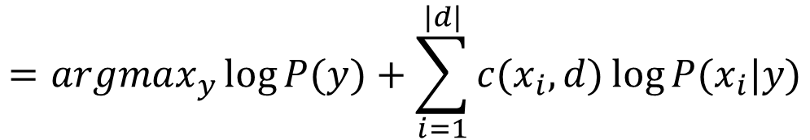
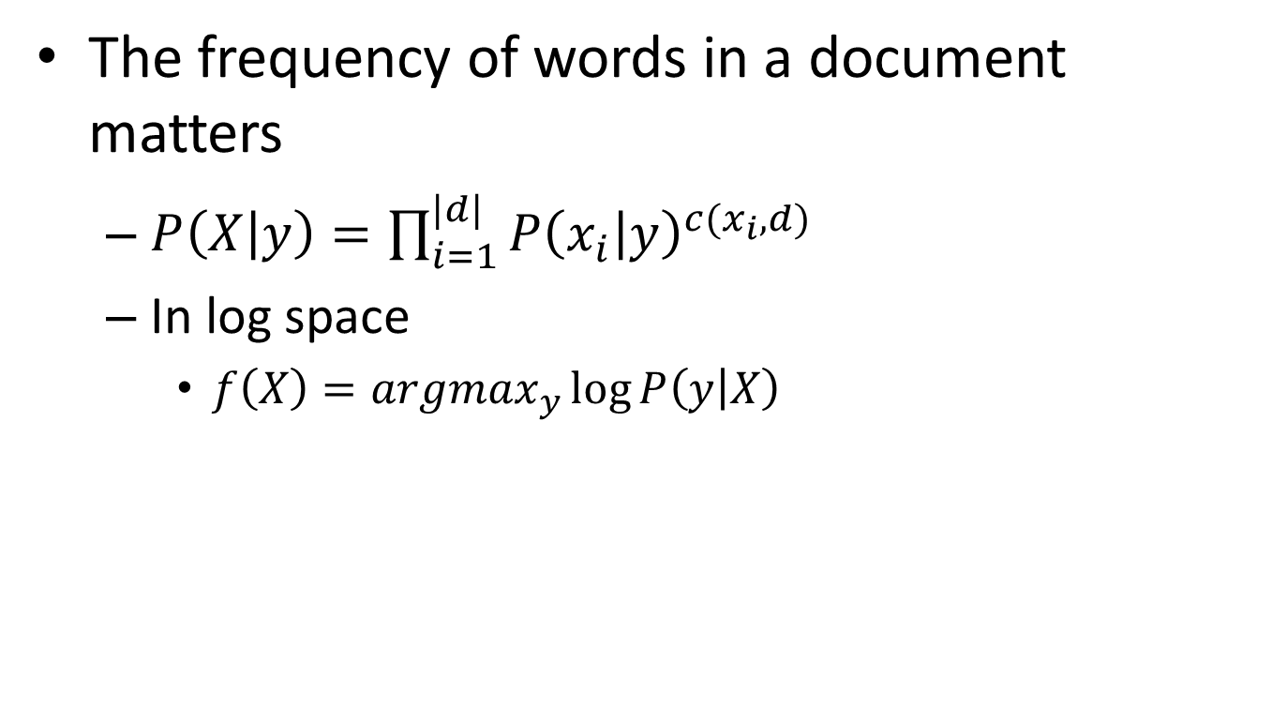
Enhancing Naïve Bayes for text classification I
The frequency of words in a document matters
$P\left(X | y\right)=\prod_{i=1}^{|d|}{P{\left(x_{i} | y\right)}^{c(x_{i},d)}}$
In log space
$f\left(X\right)=argmax_{y}\log{P\left(y | X\right)}$
Essentially, estimating $|Y|$ different language models!
$$=argmax_{y}\log{P(y)}+\sum_{i=1}^{|d|}{c(x_{i},d)\log{P(x_{i}|y)}}$$
Class bias
Feature vector
Model parameter

Slide 38
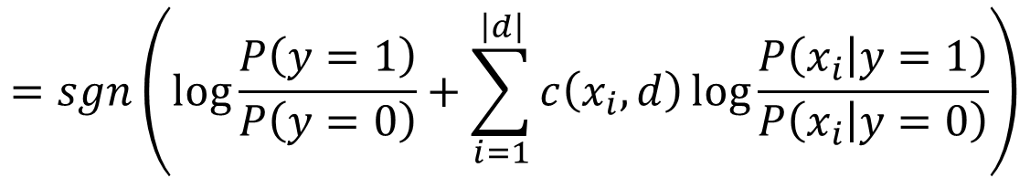


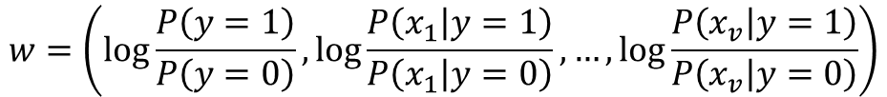

Enhancing Naïve Bayes for text classification
For binary case
$f\left(X\right)=sgn\left(\log{\frac{P\left(y=1 | X\right)}{P\left(y=0 | X\right)}}\right)$
$$=sgn\left(\log{\frac{P\left(y=1\right)}{P\left(y=0\right)}}+\sum_{i=1}^{\left|d\right|}{c\left(x_{i},d\right)\log{\frac{P\left(x_{i} | y=1\right)}{P\left(x_{i} | y=0\right)}}}\right)$$
$$=sgn(w^{T}\overline{x})$$
a linear model with vector space representation?
where
$$w=\left(\log{\frac{P\left(y=1\right)}{P\left(y=0\right)}},\log{\frac{P\left(x_{1} | y=1\right)}{P\left(x_{1} | y=0\right)}},…,\log{\frac{P\left(x_{v} | y=1\right)}{P\left(x_{v} | y=0\right)}}\right)$$
$$\overline{x}=(1,c(x_{1},d),…,c(x_{v},d))$$
We will come back to this topic later.

Slide 39
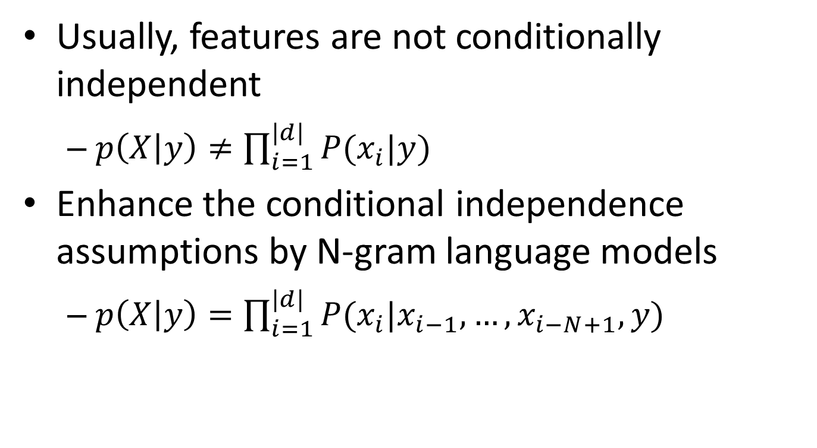
Enhancing Naïve Bayes for text classification II
Usually, features are not conditionally independent
$p\left(X | y\right)≠\prod_{i=1}^{|d|}{P(x_{i}|y)}$
Enhance the conditional independence assumptions by N-gram language models
$p\left(X | y\right)=\prod_{i=1}^{|d|}{P(x_{i}|x_{i−1},…,x_{i−N+1},y)}$

Slide 40
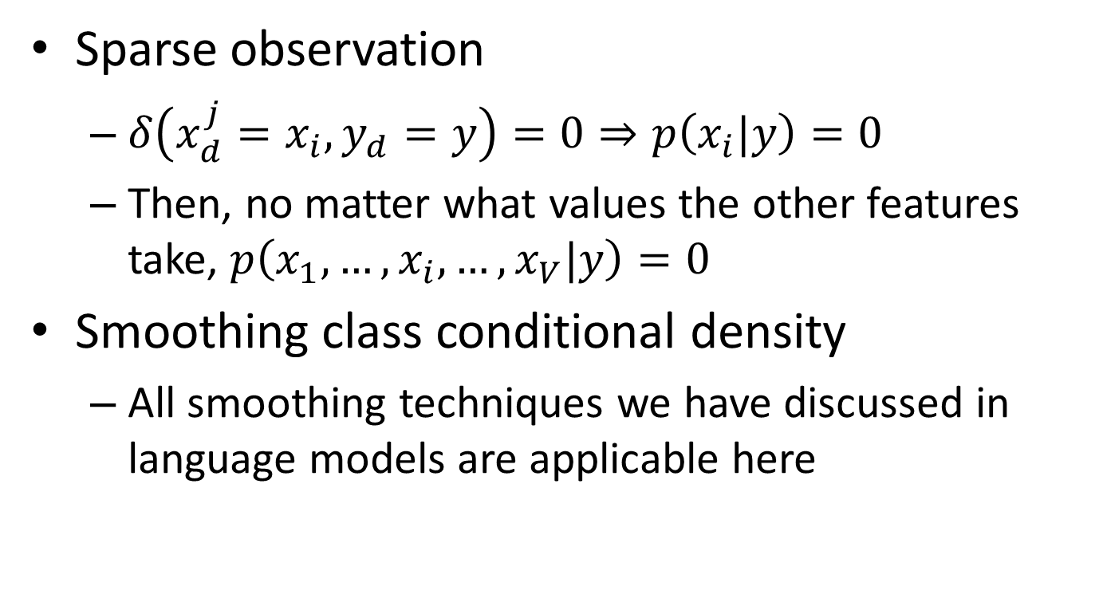
Enhancing Naïve Bayes for text classification III
Sparse observation
$δ\left(x_{d}^{j}=x_{i},y_{d}=y\right)=0⇒p\left(x_{i}|y\right)=0$
Then, no matter what values the other features take, $p\left(x_{1},…,x_{i},…,x_{V}|y\right)=0$
Smoothing class conditional density
All smoothing techniques we have discussed in language models are applicable here

Slide 41
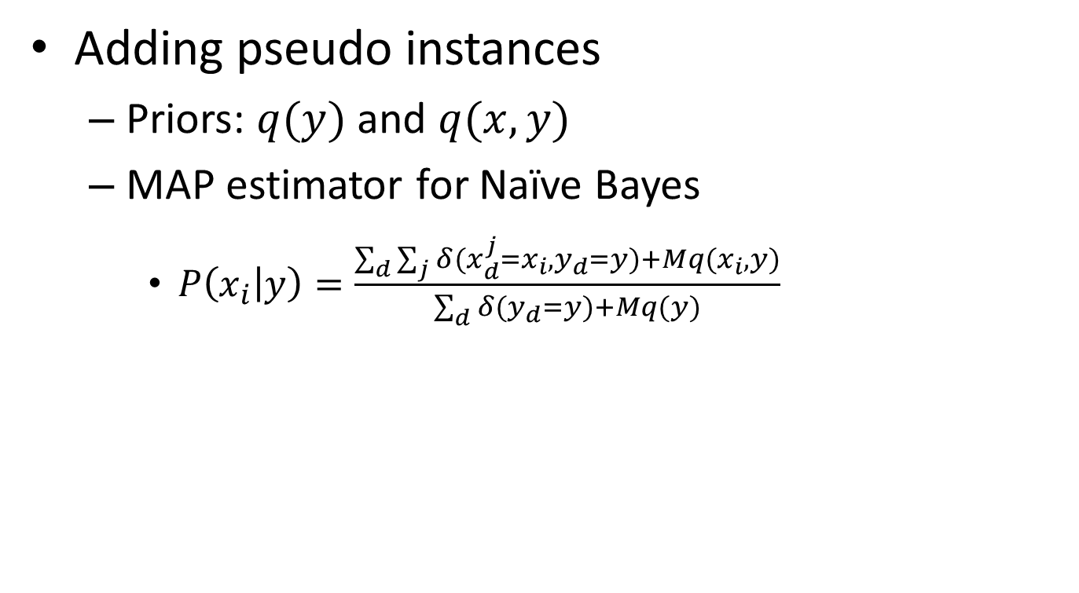
Maximum a Posterior estimator
Adding pseudo instances
Priors: $q(y)$ and $q(x,y)$
MAP estimator for Naïve Bayes
$P\left(x_{i} | y\right)=\frac{\sum_{d}{\sum_{j}{δ(x_{d}^{j}=x_{i},y_{d}=y)}+Mq(x_{i},y)}}{\sum_{d}{δ(y_{d}=y)}+Mq(y)}$
Can be estimated from a related corpus or manually tuned
#pseudo instances

Slide 42
Summary of Naïve Bayes
Optimal Bayes classifier
Naïve Bayes with independence assumptions
Parameter estimation in Naïve Bayes
Maximum likelihood estimator
Smoothing is necessary

Slide 43
Today’s reading
Introduction to Information Retrieval
Chapter 13: Text classification and Naive Bayes
13.2 – Naive Bayes text classification
13.4 – Properties of Naive Bayes
Chapter 14: Vector space classification
14.3 k nearest neighbor
14.4 Linear versus nonlinear classifiers

